Slide 1

Project Name :-
AI-Powered Personal Productivity
WebAI Hackathon 2025
Presented by -Atharv Milind Suryavanshi

Slide 2

The Productivity Challenge
Unorganized Tasks
Poor Time Management
Information overload and fragmented workflows.
Struggling to prioritize and allocate time effectively.
Lack of Tracking
No clear overview of daily progress and achievements.
Solving these pain points requires a smart, AI-driven system for effective task management.

Slide 3

Our Vision: Smarter Productivity
Build a web-based personal productivity dashboard with seamless AI integration.
Progress Tracking
1
Smart Schedules
2
Actionable Insights
3

Slide 4






Powerful Features at Your Fingertips
Secure Login
Interactive Dashboard
Personalized user access.
Visual progress tracking.
Intuitive Task Manager
Dynamic Calendar View
Prioritize high, medium, low tasks.
Visualize deadlines & completion.
AI Smart Planner
Modern UI/UX
Generates daily schedules.
Clean sidebar navigation.

Slide 5
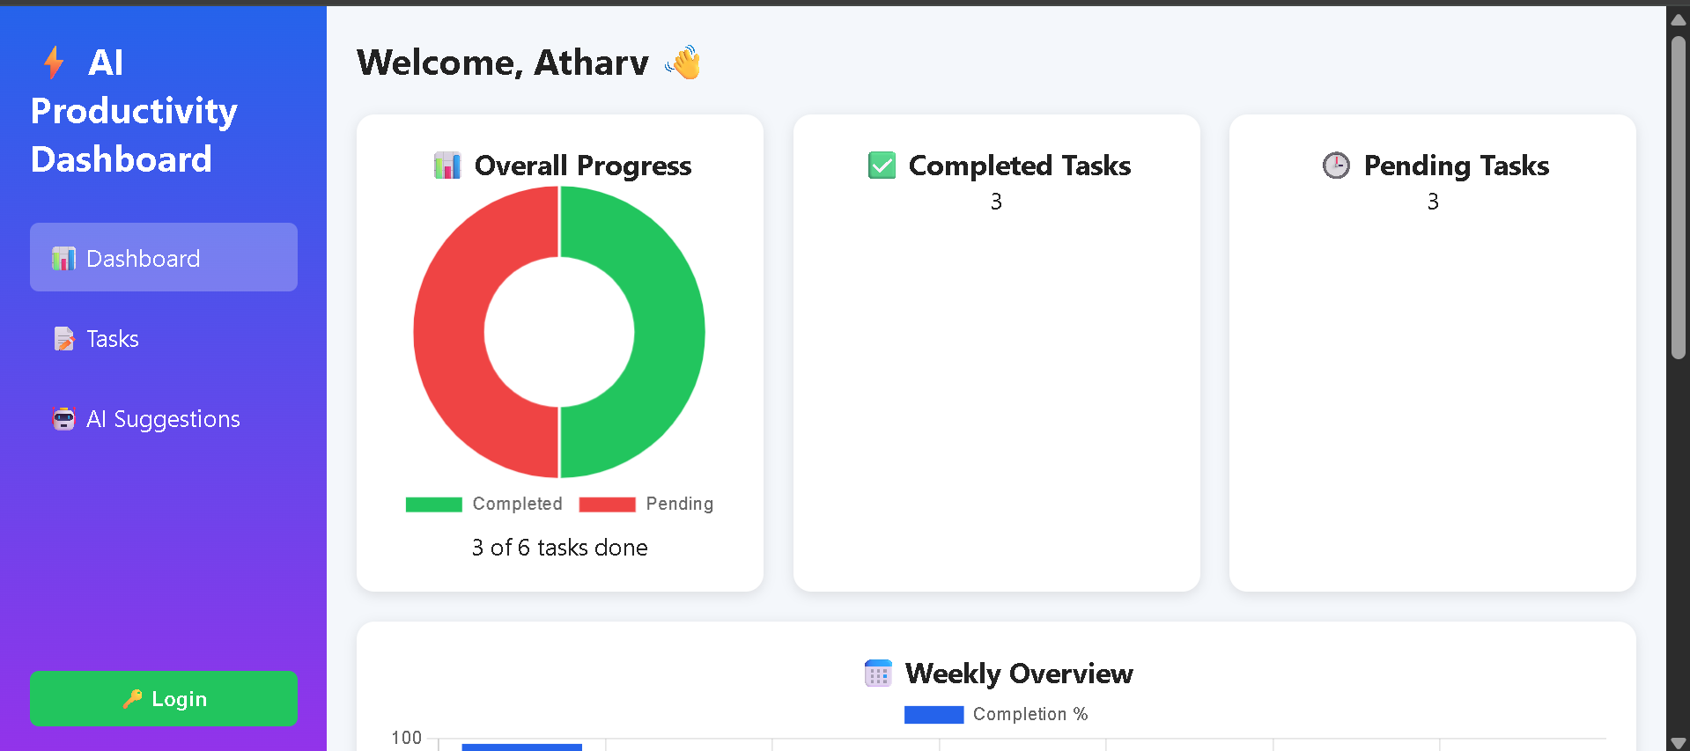
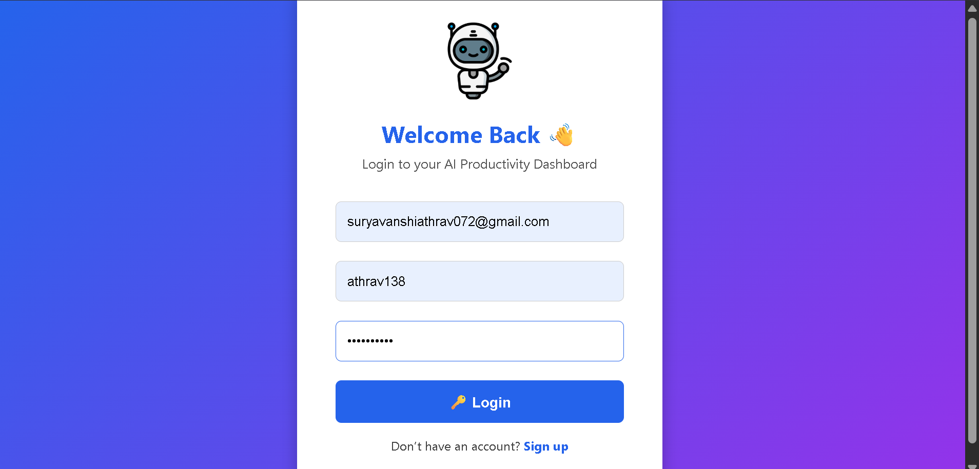
Technology Under the Hood
Frontend Foundation
Key Libraries & Tools
HTML5 for structured content
Chart.js: Progress & Weekly Charts
CSS3 for modern styling
FullCalendar.js: Calendar Integration
JavaScript for dynamic interactivity
Flaticon: Extensive Icon & Illustration Library
Google Fonts: Elegant Typography

Slide 6
Seamless User Journey: Workflow
01
02
03
Access Dashboard
Add & Prioritize Tasks
Visualize Progress
User logs in securely.
Input tasks with priority levels.
Dashboard updates with charts.
04
05
Calendar Sync
AI Generates Schedule
Completion percentages highlight on calendar.
Personalized daily plans created.

Slide 7
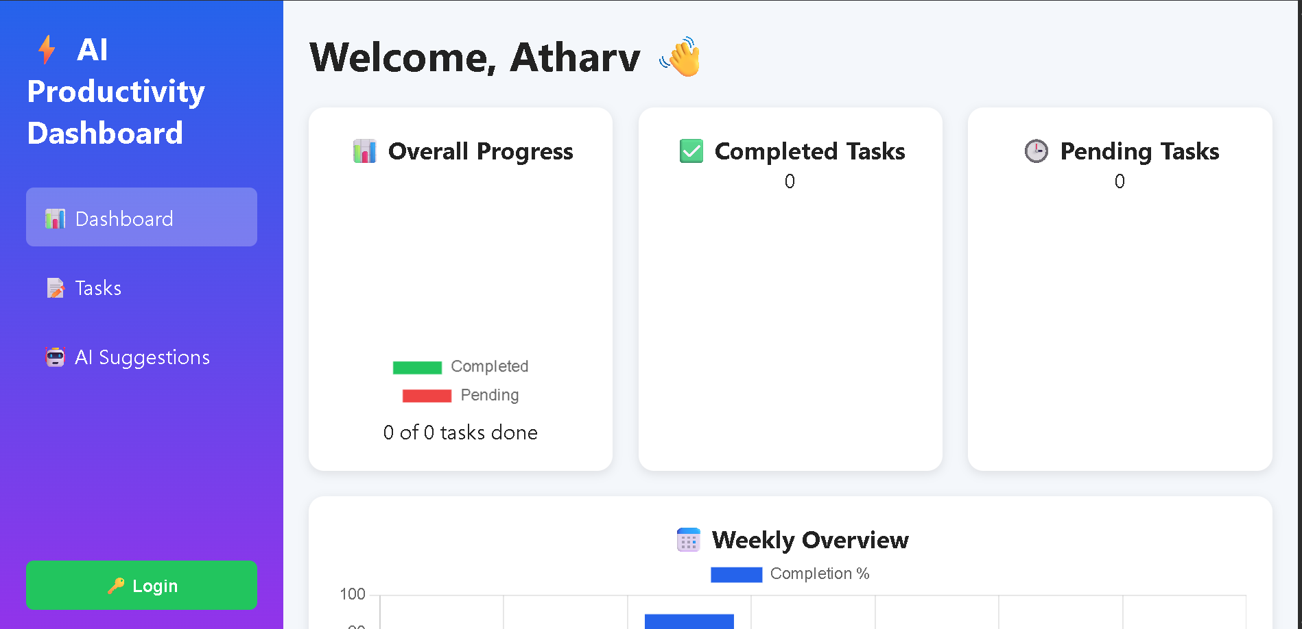
Visualizing WebAI: UI Preview
A glimpse into the clean and intuitive design.

Slide 8
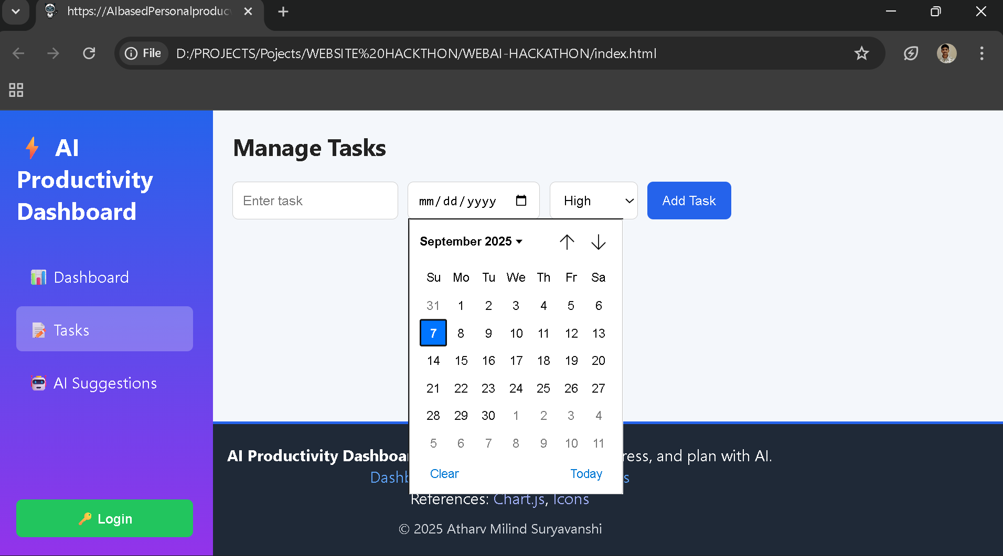
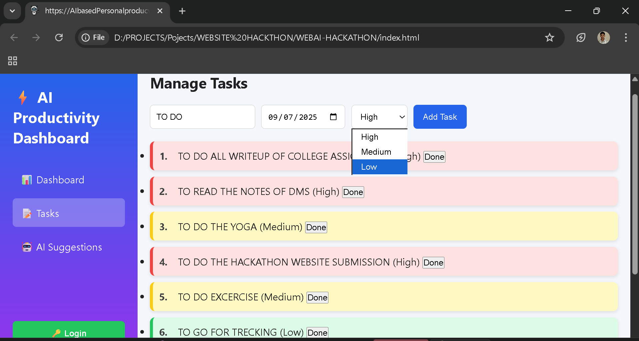

Slide 9
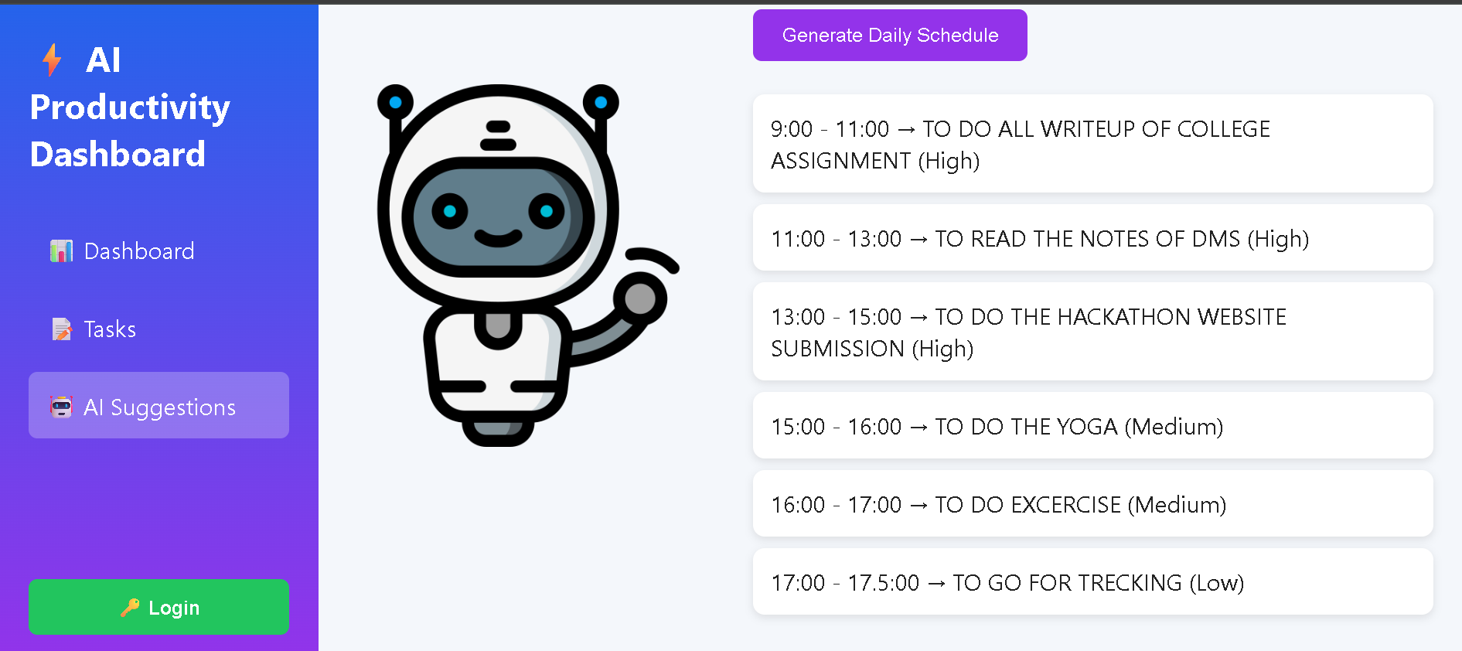
AI at the Core: Intelligent Automation
Priority Logic
AI Time Scheduling
High > Medium > Low task focus.
Optimized task allocation.
Auto Routine Creation
Daily schedules from 9:00 AM.
Future Enhancements
Seamless Google Calendar synchronization
Proactive AI reminders and notifications
Deeper personalized insights & analytics

Slide 10
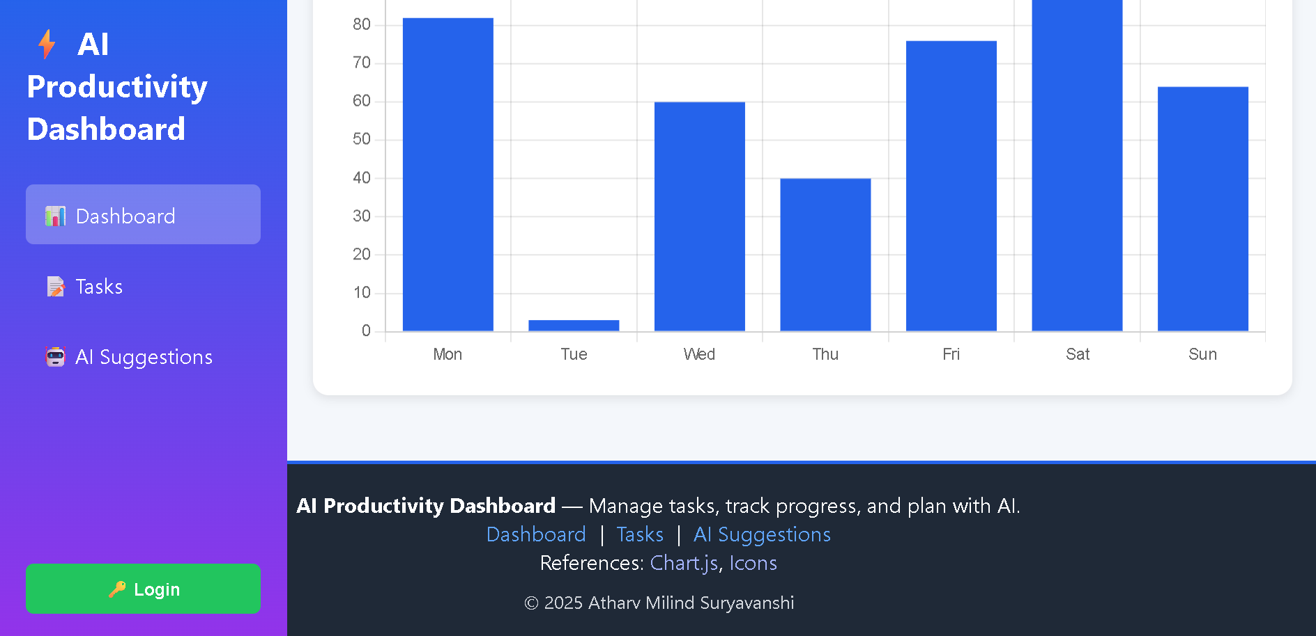





Foundations & Collaboration
Chart.js
FullCalendar.js
Robust data visualization library.
Dynamic event calendar display.
Flaticon
Google Fonts
Diverse collection of vector icons.
High-quality, web-optimized fonts.

Slide 11

WebAI: Your Future Productivity
Manage your tasks and goals with our web application and do your future best

Slide 12
THANK YOU

